Slide 1
Nazi
Economic Policy

Slide 2
Situation in 1933
Short of raw materials
Little Foreign currency to pay for imports
6 million Germans unemployed
Confidence & therefore investment low
However the worst of the Depression was over before 1933
Moratorium (suspension) of international debts in 1931/2

Slide 3
Aims: What factors influenced economic policy?
Aims
Tackle Depression
Wehrwirtschaft (Managed/defence/war economy)
Limit influence of foreign capital
Create an economy that serves ideological purposes
Fulfill promises – 25 Points?

Slide 4
How did the Nazi’s Stimulate the Economy?

Slide 5
Nazi Economic Aims | Important Individual | Key Measures | Successes & Failures
Recovery 1933-6 How did the Nazi’s Stimulate the Economy? 1934 New Plan | Hjalmar Schacht as President of Reichsbank in 1933 and Economics Minister in 1934 | Job Creation through Public Works: homes, motorways Increase public expenditure & investment Tried to stimulate consumer demand Tax concessions and grants for newlyweds Some groups pressurized out of employment (married women and Jews in public service) Reduce eligibility for unemployment relief – agricultural workers Reich Labour Service (RAD) took many off unemployment register (400,000 in 1934) 1935 Conscription removed males 18-25 for 2yrs service (armed forces grew from 100,000 in 1935 to 1,400,000 in 1939) Schacht used deficit financing & Mefo Bills (Reichsbank credit notes) to boost economy 1934 Schacht created the New Plan to tackle the problem – govt powers to regulate foreign exchange (imports had to be approved by govt). New Plan 1934: Govt regulation of imports. Development of trade with less developed countries (central & SE Europe) | Mefo Bills account for 50% of government expenditure in 1934-35 (they also disguise rearmament spending) Hitler benefitted from Bruning’s arrangement to suspend Reparations Payments By 1935 there were 2.5 million unemployed (by 1939 there was a labour shortage) By 1934 measures were causing a balance of trade deficit (importing more than exporting) and gold reserves running low New Plan overcame immediate balance of trade problem but increased demand and rearmament still creating high demand for imports

Slide 6
Why did Hitler succeed where Weimar had failed?
Luck – the Depression was passing by late 1932
He benefitted from work creation programmes initiated in 1932
Hitler prepared to adopt policies of greater state intervention and deficit financing
Determination – making unemployment a top priority
Enabling Law – no formal constraints on decision making
Repression of Trade Unions restored business confidence
Psychological effects of ending reparation payments

Slide 7
How successful was the drive for rearmament 1936-9?

Slide 8
Nazi Economic Aims | Important Individual | Key Measures | Successes & Failures
Rearmament 1936-9 How successful was the drive for rearmament 1936-9? 1936 Four Year Plan | Schacht From 1937 Herman Goering (Head of Luftwaffe) The Office of the Four-Year Plan. | Schacht becoming increasingly concerned at the distortion: wanted to encourage exports and slow arms expenditure Hitler – Schacht rift: Puts Herman Goering (Head of Luftwaffe) in charge of new economic organisation. The Office of the Four-Year Plan. His office cut across existing economic ministries and intervened with regulations to control: foreign exchange, labour, raw materials & prices. Four-Year Plan: Priority to rearmament, self-sufficiency in food & industrial production (Autarky). Emphasis on devlopment of raw materials & machinery production. The government set targets that private industry had to meet. Autarky policy aimed to: increase Germany’s production of key commodities e.g. iron & food, develop ersatz (substitute) products e.g. Buna – artificial rubber or use coal to produce oil. | 1936 A turning point: confidence restored. Unemployment reduced to 1.6 million Rearmament put a strain on the economy Real wages increased overall but the price of food rose (poor peasants & urban workers suffer) It took 6 tons of coal to produce 1 ton of oil! By 1939 Germany still depended on foreign imports for 1/3 of its raw materials – especially iron ore, oil and rubber. (Occupation of other countries became a more effective method of achieving “self-sufficiency”

Slide 9
Impact of the drive for rearmament
The Four-Year Plan was not based on a plan for a specific war in 1940. Hitler considered a major war more likely to be 1942-3. It was part of plans aiming at readiness for war in the mid 1940’s.
Hitler was unable to subordinate all other areas to the rearmament drive and the regime faced serious problems concerning military supplies when war broke out.
“Guns & Butter”

Slide 10
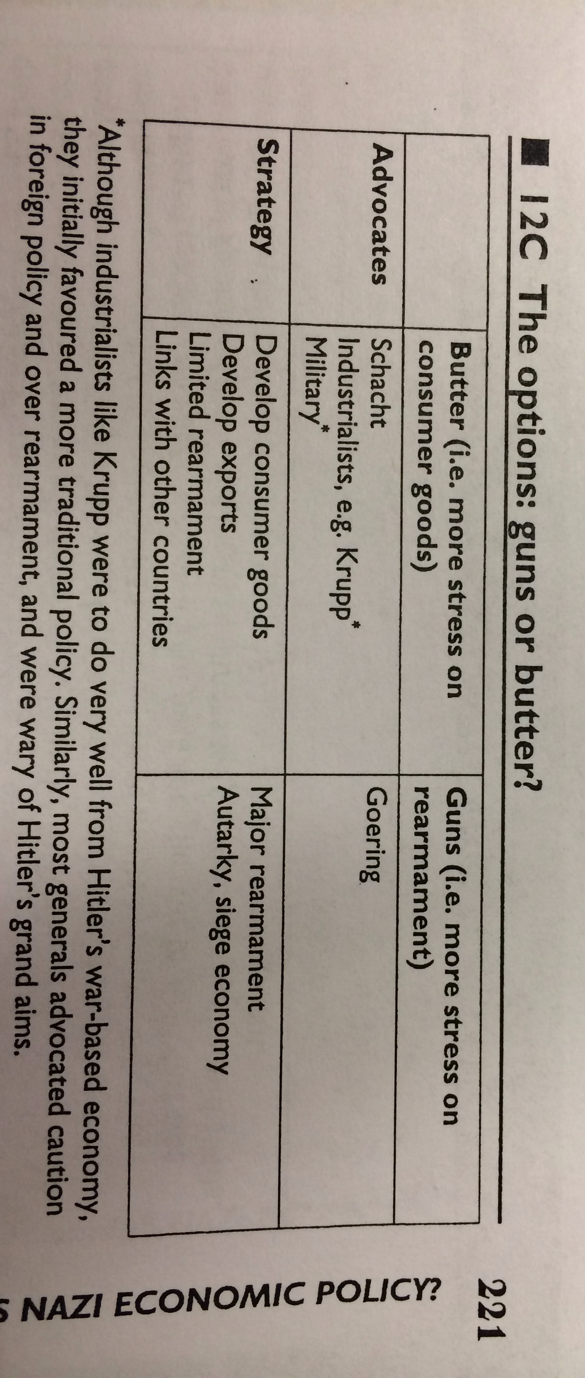
Guns or Butter?

Slide 11
Area | What was the govt role? | How were dev influenced by ideology? | How far was this policy successful
Agriculture | Autarky Peasant Measures Subsidies – arable farmers Price controls Reich Food Estate – regulations Four Year Plan Reich Entailed Farm Law – small farms decline | Autarky: Priority for military not agricultural machinery – no growth. Limited mechanisation. Blood & Soil | Livestock farmers hit badly. Imported fodder costs Production fails to meet demand Fats crisis
Industry | State Supervision All firms were part of Reichsgruppe for Industry – part of Reich Economic Chamber. Industry remained privately owned. Four Year Plan National Herman Goering Steelworks – pressurised private steel industry to invest 130 million marks |  | Large firms such as Krupps, IG Farben and Daimler-Benz expand. Small business decline
Transport | Supreme Reich Authority |  | 2,000 miles of autobahn by 1938 – success Boost unemployment Military value Prestige Railways comparative neglect – competing demands for use Planes – symbolise new modern Germany
Trade & Finance | Centralised control. | Autarky | No major growth in 1930’s Mefo Bills Confidence grew and allowed maintenance of budget deficit

Slide 12
Who gained the most from the Nazi Economy?
Social Group | Benefits of Nazi Rule | Drawbacks of Nazi Rule
Elite & Big Business
Mittelstand
Workers
Use pp 227-231 of the SHP handout to complete this table

Slide 13
Historiography
Historians who question the “strong dictator” theory (Richard Overy & Ian Kershaw) would argue that there was no coherent Nazi Economic Policy so it is wrong to ascribe the term “Nazi Economic Miracle” to what happened after 1933. Most policies evolved according to political whims.
“Guns & Butter”: Debate over how wary Hitler was of squeezing domestic consumption too far – therefore how “totalitarian” was the Nazi State? Also, the need to try and supply both guns and butter hindered the rearmament program therefore this questions the “strong dictator” model. Overy argues that the key point is to distinguish between the period 1933-6 (public works etc) and period after 1936 (war economy)

Slide 14
How successful was Nazi economic policy?
In many ways it was very successful
  Restored full employment
  Built up economic strength so that Germany dominated Europe by 1941
  Made Hitler a popular leader
  Recovery from Depression
However extent that Hitler was responsible for success debated
  It had begun by 1933
  Other policies may have led to more sustained and faster growth
  Priorities meant that mass of German people failed to greatly benefit from economic growth
  Autarky not achieved
  Rearmament was wasteful and disorganized until Albert Speer rationalized the system in 1942
  Nazi economic policy was geared to war and in this Germany ultimately failed

Slide 15
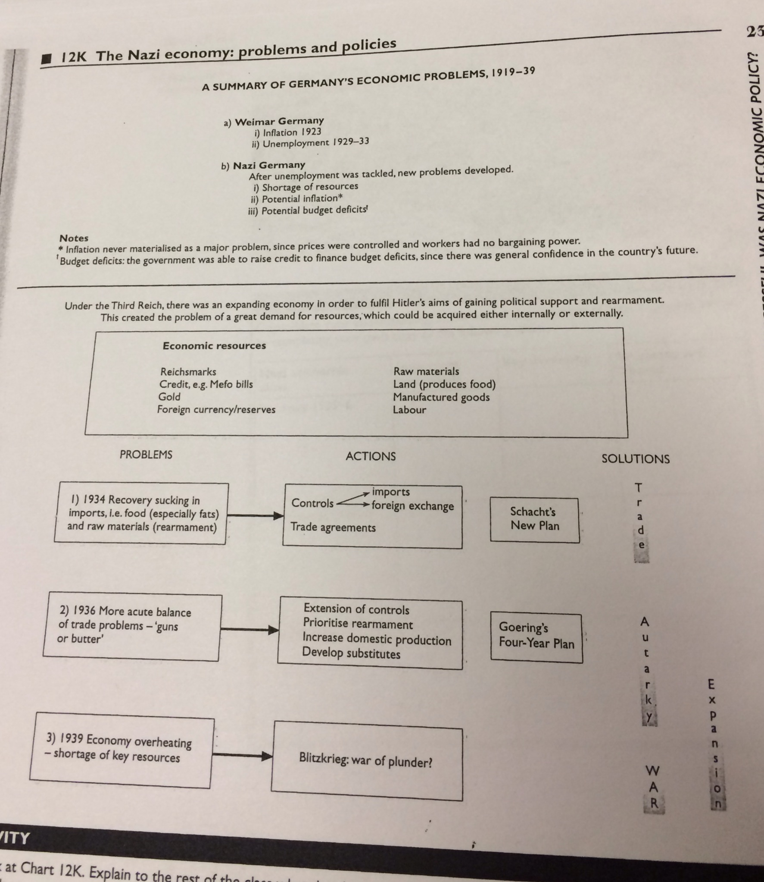
Summary of economic problems

Slide 16
Was the economy ready for war in 1939?
Did an economic crisis push Germany into war?

Slide 17
Historiography
Mason v Overy

