Slide 1
Nazi Foreign Policy

Slide 2
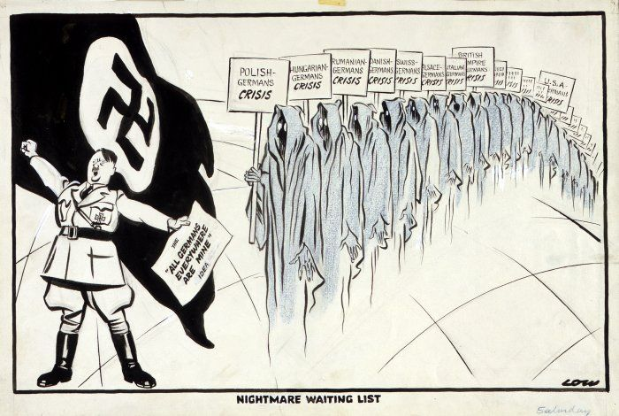
The Road to War
1933 - 1939

Slide 3
Do you agree with Churchill?
In his account of the causes of World War II, The Second World War: Volume One, The Gathering Storm, 1948. Winston Churchill asserted that Hitler had a master plan for the domination of Europe, which Hitler had outlined in Mein Kampf.
Churchill went on to discuss that the “granite pillars” of his plan were to reunite Germans in a Great German Empire and to conquer Eastern Europe by force.
War was inevitable in attaining these goals, and Hitler pursued these ambitions by creating a militarized nation. In Churchill’s analysis 1935 was a turning point when Germany rearmed; from that point on war was the only way to stop Hitler.

Slide 4
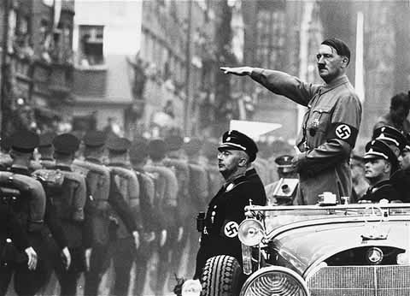
HITLER’S FOREIGN POLICY AIMS
TO ABOLISH (TEAR UP) THE TREATY OF VERSAILLES
TO REARM AND MAKE THE GERMAN PEOPLE THE MASTER RACE
TO FIGHT TO EXPAND GERMAN TERRITORY (LEBENSRAUM = LIVING SPACE)
TO REUNITE ALL GERMAN SPEAKING PEOPLE (IRREDENTISM

Slide 5
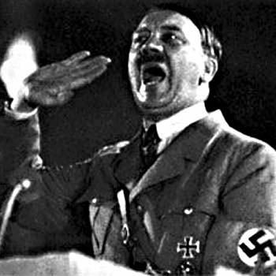
Hitler’s Foreign Policy...
I SWEAR TO “UNITE ALL ETHNIC GERMANS INTO THE BODY OF THE REICH!!!”
LIKE MANY THINGS ASSOCIATED WITH HITLER AND THE NAZIS THIS PROCESS WAS NOT NEW TO HISTORY... IT IS KNOWN AS...
IRREDENTISM

Slide 6
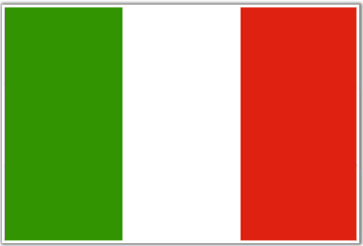
IRREDENTISM
WHAT DOES IT MEAN???
IT COMES FROM THE ITALIAN “IRREDENTO” MEANING “UNREDEEMED”...
IT MEANS WHEN ONE COUNTRY TAKES BACK LAND CONTROLLED BY ANOTHER COUNTRY ON THE GROUNDS OF COMMON ETHNICITY OR PRIOR HISTORICAL POSSESSION

Slide 7
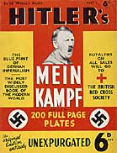
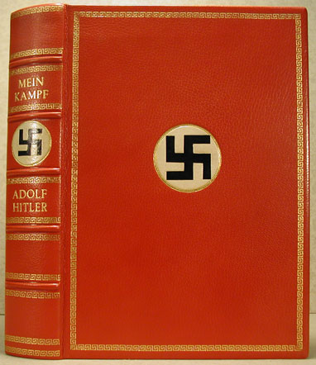
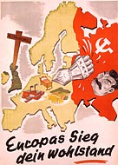
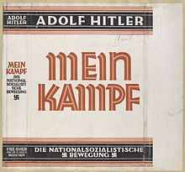
The Versailles Treaty is worthless. 60 million German hearts and minds are on fire with anger and shame. They will cry out ‘We want war!’
It will be the duty of German foreign policy to get large spaces to feed and house the growing population of Germany. Destiny points us towards Russia.
The menace of Russia hangs over Germany. All our strength is needed to rescue our nation from this international snake.

Slide 8
Rearmament
Hitler had only been in power for a year when he issued his first orders to expand the armed forces. By 1934 he had increased the army to 240,000 men (twice the amount allowed by ToV).
March 1935 – announces existence of Luftwaffe
In 1935 Hitler publicly introduces conscription (compulsory military service) in order to build the army up to 550,000 men.
Britain, France and Italy condemned Hitler’s announcement, but no country took military action to stop this breach of the Treaty of Versailles.
1936 Four Year Plan – focus on rearmament

Slide 9
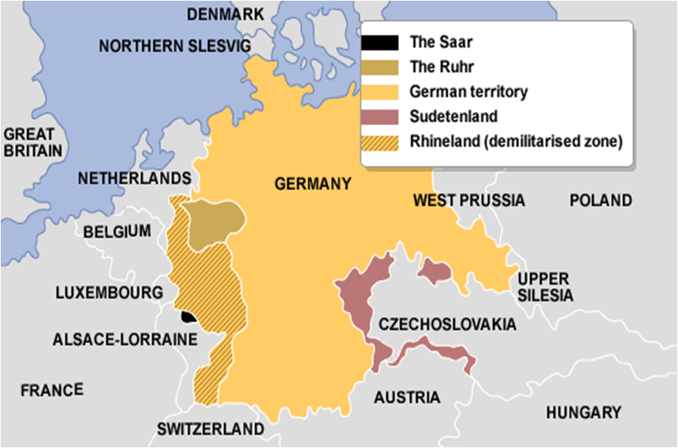
The Nazis began an intensive pro-Germany campaign led by
propaganda chief Joseph Goebbels. As early as 1933, complaints that the Nazi campaign amounted to a “reign of terror” had been noted by members of the commission overseeing the plebiscite. Although the Nazis did tone down their tactics by the end of 1934, the League of Nations provided a peacekeeping force to monitor the plebiscite.
Voter turnout plebiscite was 98%, with 90.8% voting to re-join the German Reich
Reunite: Saar Plebiscite 1935

Slide 10
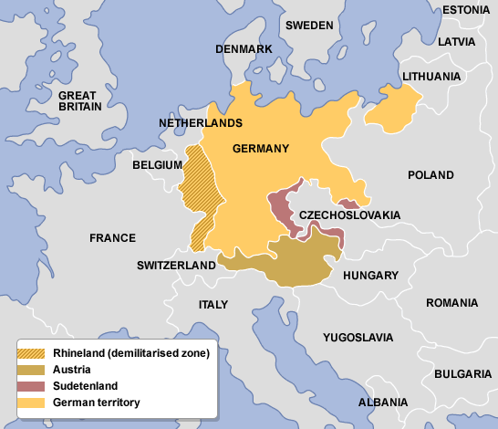
MARCH 1936 REOCCUPATION OF THE RHINELAND
The Treaty of Versailles forbade the German army from being within 50 kilometres of the River Rhine. In 1926, Britain and France agreed to use their armies if German troops moved into this area. Yet in 1936, Hitler ordered his army to march into the Rhineland.

Slide 11
THE IMPORTANCE OF THE REOCCUPATION OF THE RHINELAND
This is an example of APPEASEMENT in action.
Hitler had only 30,000 fully equipped troops.
It shows the democracies were not willing to enforce Versailles.
It shows the military weakness of the democracies.
It increased Hitler’s prestige.
It may have been their last chance to stop Hitler before his military forces became too strong.

Slide 12
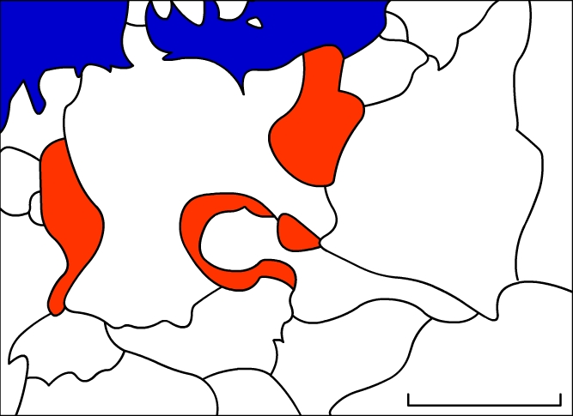
The Rhineland – this was demilitarized under the Treaty of Versailles to protect France & Belgium
Polish Corridor – this split Germany in two, and left many Germans under foreign rule.
The Sudentenland – richest part of Czechoslovakia. Contained 3 million German speakers, and had been part of Austrian Empire
Germany
Poland
France
Czechoslovakia
Austria
Austria – 8 million German speakers, many of whom wanted to join with Germany.
Hungary
0
500
km
Reunite

Slide 13
Hitler was keen to incorporate the German-speaking country of Austria into the Third Reich. Anschluss was forbidden by the Treaty of Versailles so Hitler wanted to create a situation that meant the Nazis were invited into Austria.
In 1938, Hitler ordered the Austrian Nazi Party to start causing trouble in Austria. They set fire to buildings, organized fights and even set off bombs. The Austrian leader, Kurt Schuschnigg, retaliated by banning the Austrian Nazi Party.
Hitler met with Schuschnigg and threatened to invade Austria if he didn’t give all the important jobs in the government to Nazis. Schauschnigg had to agree, but tried to get round it by organising a plebiscite (vote) to see whether the Austrians wanted to join with Germany or stay independent.
Hitler moved his army to the Austrian border. Schuschnigg asked Italy, France and Britain for their protection, but they refused to help, so Schuschnigg had to resign. He was replaced by an Austrian Nazi who asked Hitler to send in the German army to help restore order.
Reunite: Annexing Austria 1938

Slide 14
As you can see from the map, Czechoslovakia was like a thorn in Germany’s side, one which Hitler intended removing. Over 3 million Germanic people were living in Sudentenland, and they were keen to join with Germany. They supported a Nazi-style party (the Sudeten German Party) led by Konrad Henlein.
In 1938, Hitler told Henlein to stir up trouble in Sudentenland. Meanwhile, Hitler moved his troops to the Czech border. The Czechs found out and got ready to fight. They had a large army and France was their ally. Hitler had to back off.
Neville Chamberlain, the British prime minister, was sure that there would be a big war if Hitler wasn’t given Sudentenland. He persuaded France that the areas really should belong to Germany, due to its cultural make-up.
Hitler once again began to plan for invasion. Heinlein stirred up trouble again. Germans were shot and so Hitler threatened the Czechs with war.
Reunite: Sudentenland 1938

Slide 15
Chamberlain was still worried about war, and met with Hitler on several occasions throughout 1938. On 29 September 1938, Hitler, Chamberlain, Mussolini and Edouard Daladier (France) met at Munich to sign the Munich Agreement.
This compelled Czechoslovakia to surrender the Sudentenland to Germany.
Chamberlain claimed it would guarantee ‘peace in our time’.
Appeasement: Munich Conference

Slide 16
On March 16 1939, Hitler broke the Munich Agreement and invaded Czechoslovakia.
Hitler made no attempt this time to justify his actions by saying that he was simply uniting German speakers into the Reich. This was invasion, pure and simple.
Britain and France pledged to resist any further German expansion.
Unfortunately, by this time Italy had become a strong ally of Germany (PACT OF STEEL 1939), and the USSR was angry with France and Britain for not inviting her to the Munich Conference.
Expansion: Czechoslovakia 1939

Slide 17
In August 1939 Hitler signed the Nazi-Soviet Pact with communist Russia.
The pact stated that Germany and Russia would not fight each other. They also secretly agreed to attack Poland and divide it between them.
This meant that Hitler could invade Poland and reclaim the land that had been taken from Germany to make up the Polish Corridor, without worrying that the USSR would attack.
The following month, Hitler launched a massive attack upon Poland which he called ‘Blitzkrieg’ (lightning war).
Expansion: Poland 1939

Slide 18
Moderate ‘negotiator’ phase 1933-35 | Aggressive phase 1936-39
Germany still weak economically and militarily | Germany now in a position to dominate Europe
World Disarmament Conference – Bi-lateral agreements 1935 Anglo-German Naval Agreement Saar Plebiscite achieved territory peacefully Remained neutral in Abyssinia crisis | Marched into the Rhineland (‘Demilitarisation’) Anschluss Sudeten Crisis/ Marched into Prague Spanish Civil War intervention 1936-1939 Pact of Steel and Rome-Berlin Axis Invasion of Poland
But: Broke Versailles when introduced conscription Withdrew from LoN & Disarmament Conference in 1933 | But: Munich Conference? Nazi Soviet Pact?
Stages of Foreign Policy

Slide 19
1935 LoN formally censure Germany’s decision to rearm.
1935 Britain, France & Italy set up the STRESA FRONT
1935 France draws up a mutual assistance pact with Soviet Union
1935 (June) Anglo-German Naval Pact: Hitler undertakes not to build a fleet beyond 35% of total British strength. (This weakens Stresa Front).
1935 Saar is returned to Germany after a plebiscite
1935/6 Italy invades Abyssinia (Ethiopia): Diverted Italian attention and alienated Italy from GB & France. Hitler decided to remilitarize Rhineland ahead of target.
International Reactions/Steps to War

Slide 20
1936 Spanish Civil War: Franco, a fascist, was supported by German and Italian combined forces. Germany used this as a testing ground for their forces, whilst Italy were seeking new allies.
1936 Rome-Berlin Axis Agreed
1936 Anti-Comintern Pact: Between Germany & Japan, ostensibly against Communist International but by implication against USSR.
1937 November: Hossbach Memorandum
International Reactions/Steps to War

Slide 21
1938 Anschluss with Austria
The Sudentenland Crisis
1938 The Munich Agreement
1939 Invasion of Czechoslovakia

Slide 22
1939
Germany destabilised and later occupied the rest of Czechoslovakia breaking the Munich agreement
Germany continued their campaign against Poland - Germany was looking to reclaim the Polish Corridor, however, its public face only suggested a road/rail link between East Prussia and the rest of Germany. Germany wanted control back over the port of Danzig.
Polish guarantee: In March, Britain and France signed a defence treaty guaranteeing Poland independence if attacked. At this point both nations believed Germany must be stopped from further expansion.
Pact of Steel: Germany and Italy signed a military agreement in May. Italy were unprepared for war.
The Nazi soviet pact - A non-aggression pact between two ideologically divided states with a secret pact to divide Poland. USSR signed the pact partly due to the behaviour of western democracies.
September the 1st Germany invaded Poland without consulting Italy.

Slide 23
In September 1939, Germany invaded Poland. Britain declared war on Germany.
In the Spring of 1940, the German armies invaded Denmark, Norway, the Netherlands, Belgium and Luxembourg.
On 10 May 1940, the Germans invaded France. Britain was pushed back to Dunkirk.
Finally on 22 June 1940 Paris surrendered.

Slide 24
1 Hossbach Memorandum | 2 Munich Agreement | 3 Nazi- Soviet Pact | 4 Non- Aggression Pact with Poland
5 Remilitarized Rhineland | 6 Lebensraum | 7 Pact of Steel | 8 Plebiscite
9 Neville Chamberlain | 10 Polish Corridor | 11 Sudentenland | 12 Spanish Civil War
13 Stresa Front 1935 | 14 Four Year Plan | 15 Anchluss | 16 Anglo-German Naval Agreement 1935

